Slide 1



AWS Website Hosting
DEC 07,2020
Group 2: Yunyun Jiang Malikat Coulibaly

Slide 2



AWS S3
Project Objective Review
It is for simple static website hosting, serverless
AWS Lightsail
It is for deploying simple website hosting using WordPress, Joomla, Moodle and other.
Amazon S3 , Amazon Lightsail, AWS Amplify Console
AWS Amplify
It lets you create Single-Page Applications (SPAs) and allows dynamic interaction with users

Slide 3

Efficiency
1.9 Billion
COMPLEXITY OF THE PROCESS
Evaluation Criteria
Cost
1.9 Billion
THE SERVICE CHARGE
Overall Performance
1.9 Billion
APPEARANCE AND UTILITY

Slide 4

Index.html

Slide 5




Step 1
CREATE S3 BUCKET
Step 2
UPLOAD WEBSITE PAGE
AWS S3
Step 3
CHANGE BUCKET POLICY FOR PUBLIC ACCESS FOR DOMAIN BUCKET
Step 4
ENABLE WEBSITE HOSTING

Slide 6
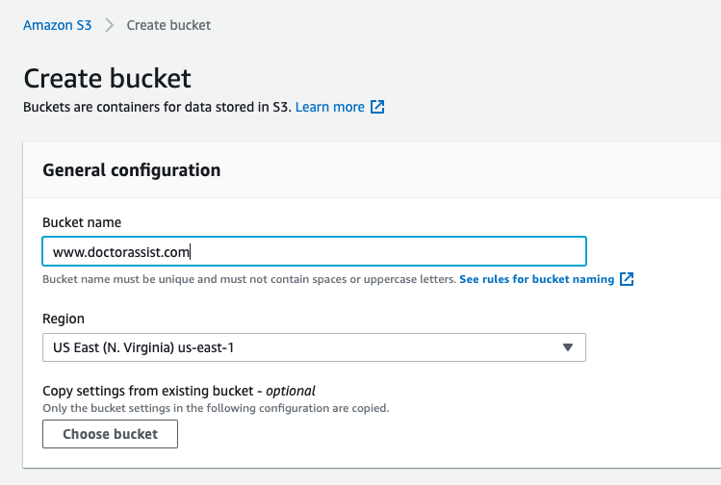
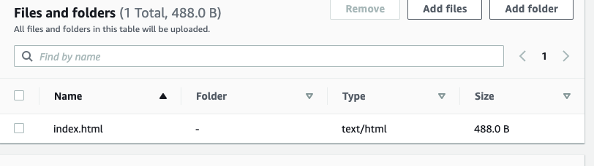
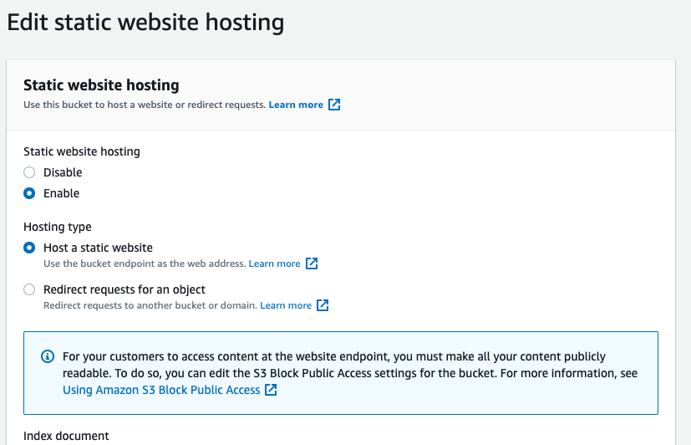

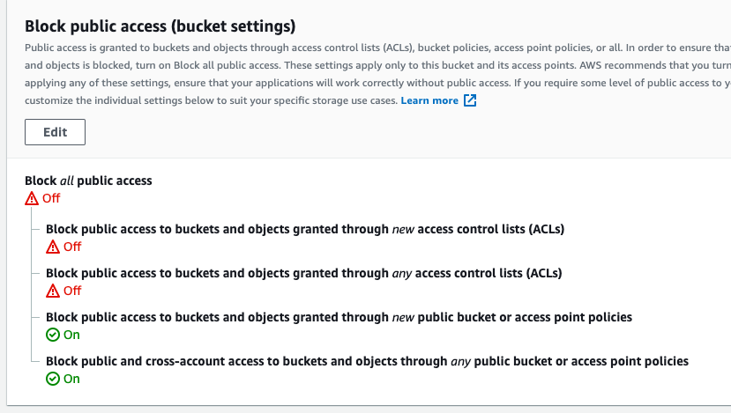

Slide 7




Simple
Summary of AWS S3
Time spend: 10 minutes
Cost: pay as needed
Performance: Fair/Good

Slide 8

Create Lightsail Account
Create WordPress Instance
Connect to instance via SSH
AWS Lightsail
With WordPress
Retrieve password for WordPress
Create Lightsail static IP address and attach to WordPress instance
Create Lightsail DNS zone

Slide 9
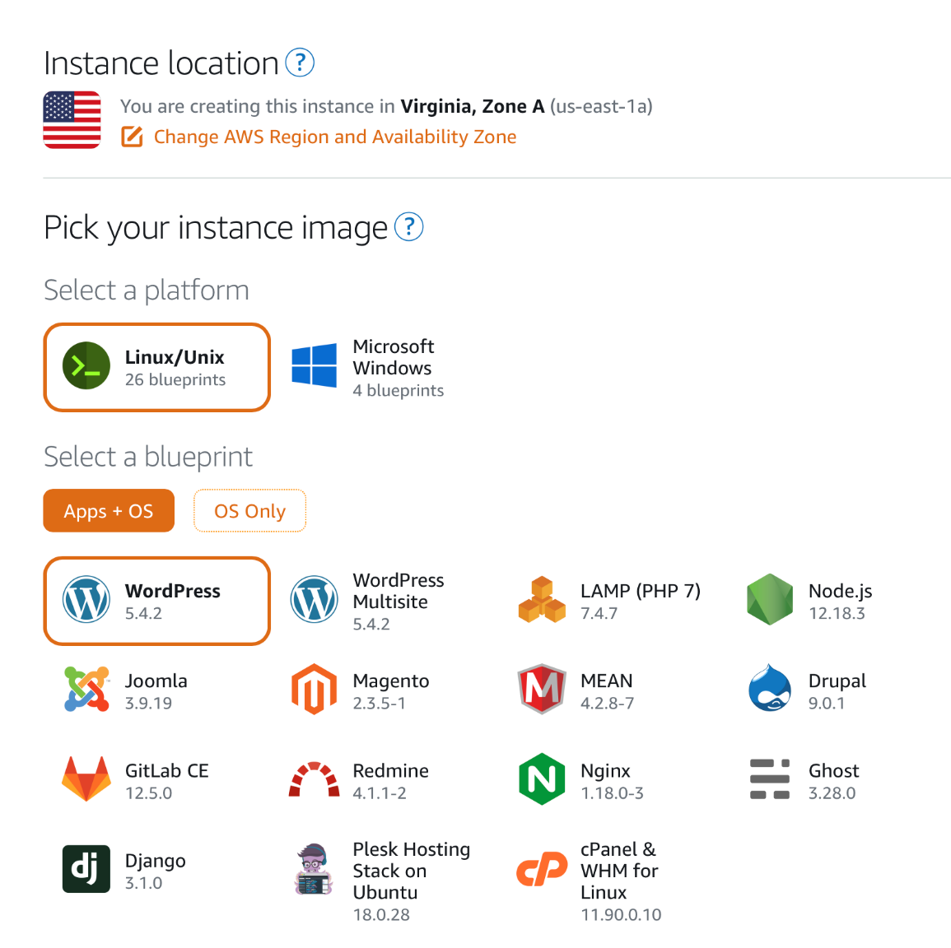
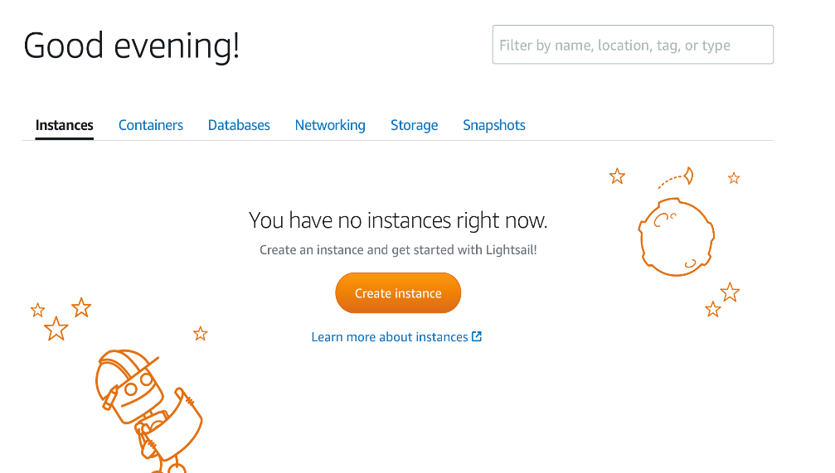
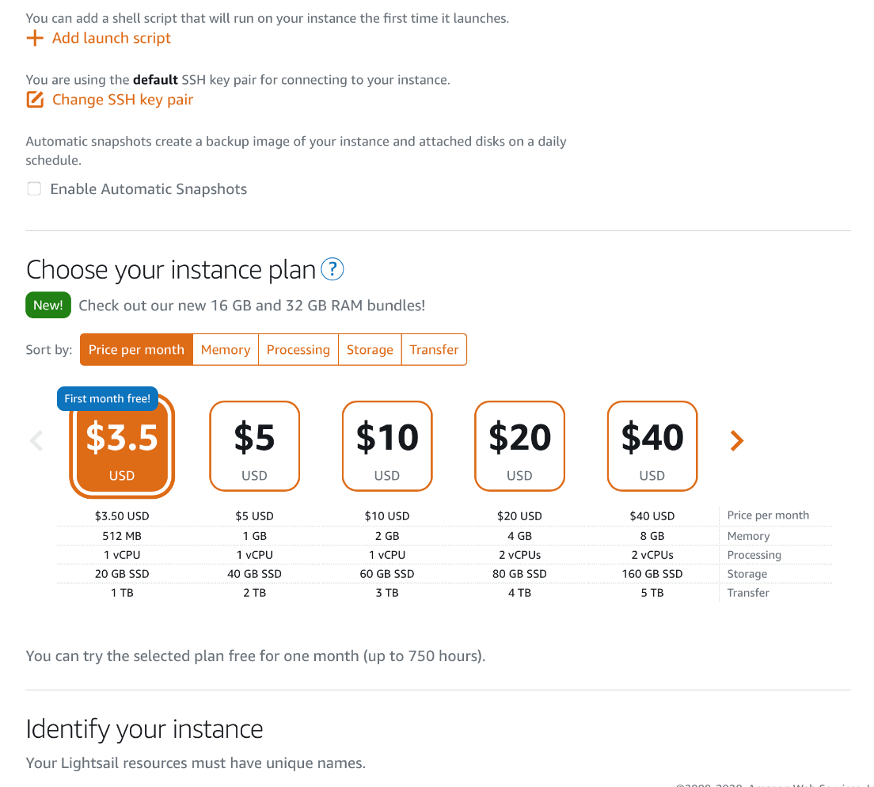
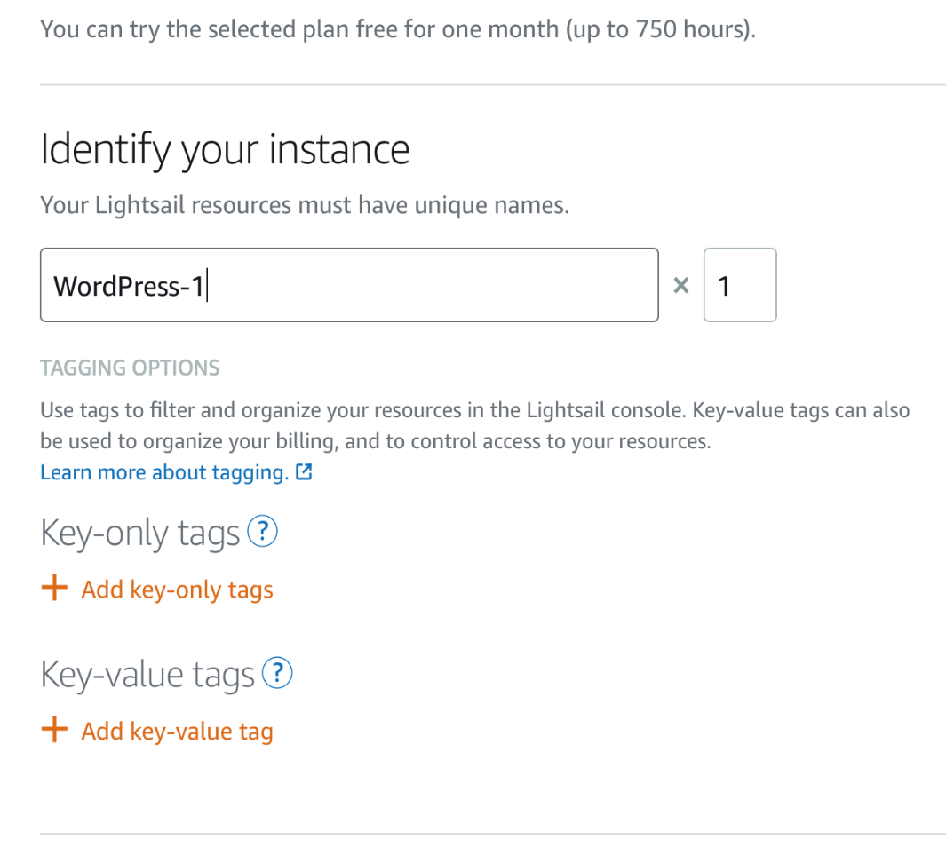
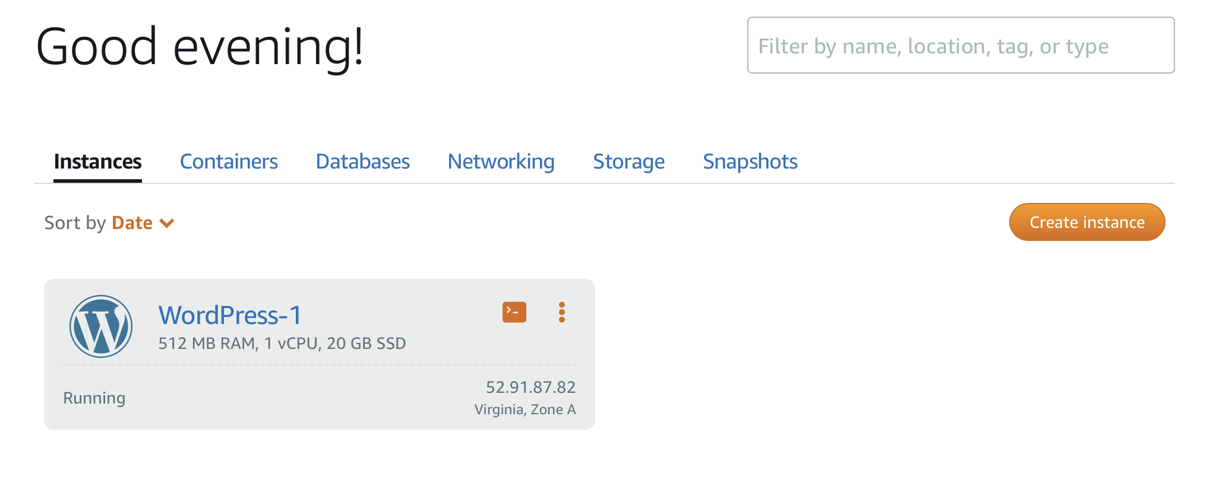
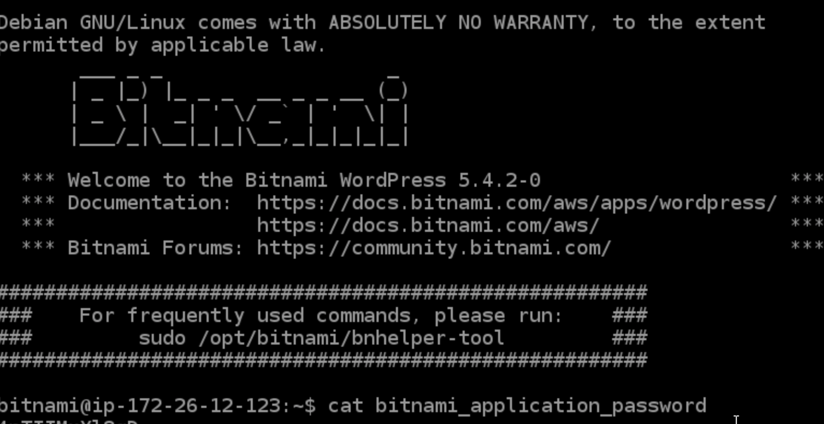

Slide 10
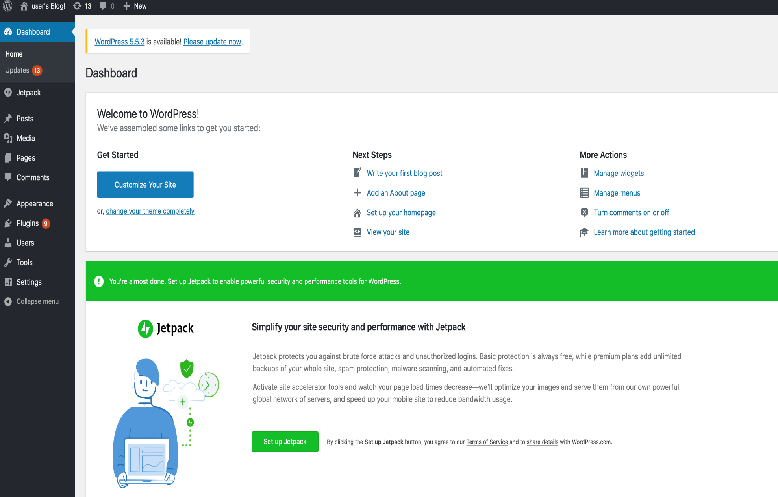
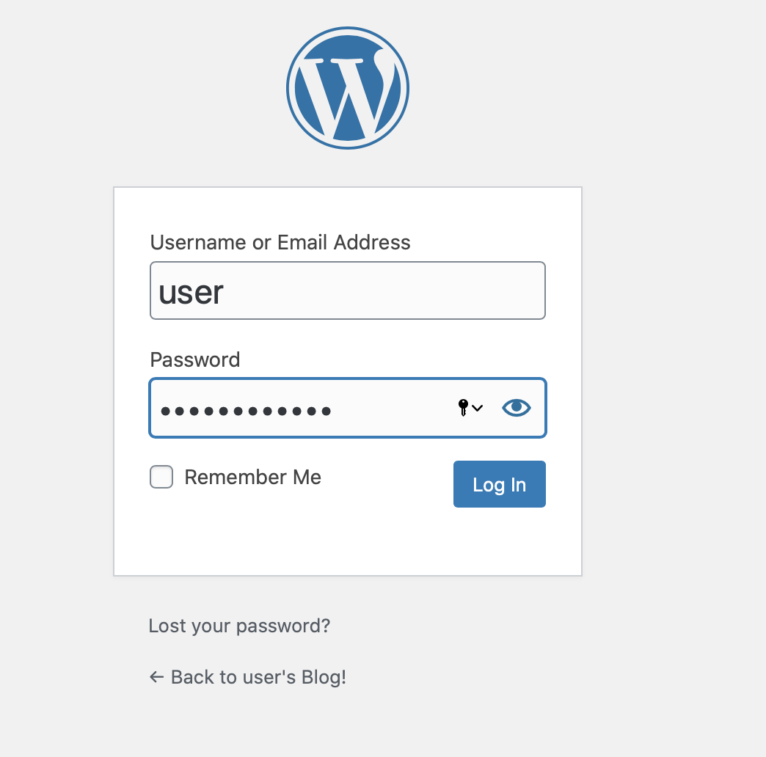


Slide 11


Level of complexity
Median
Summary of LightSail
Time spent
30 minutes
Cost
3-4 dollars at start
Performance
Good

Slide 12
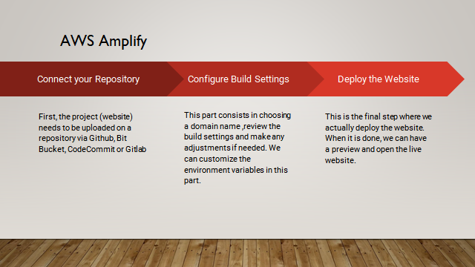

Slide 13
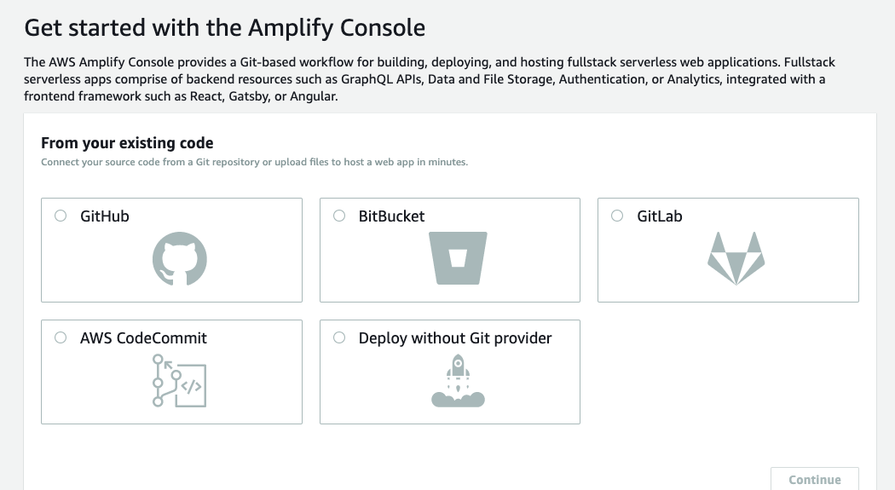
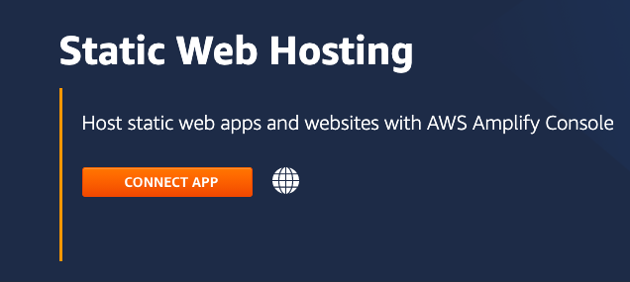
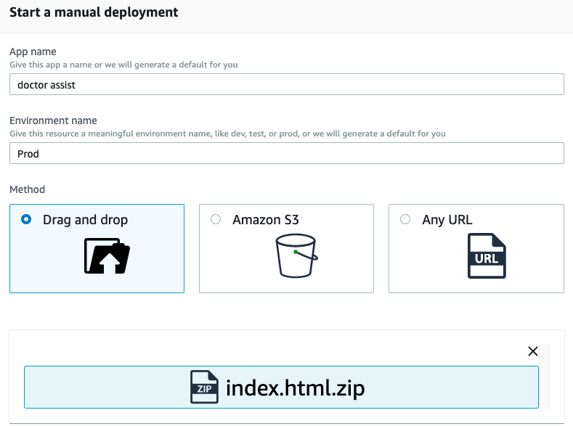
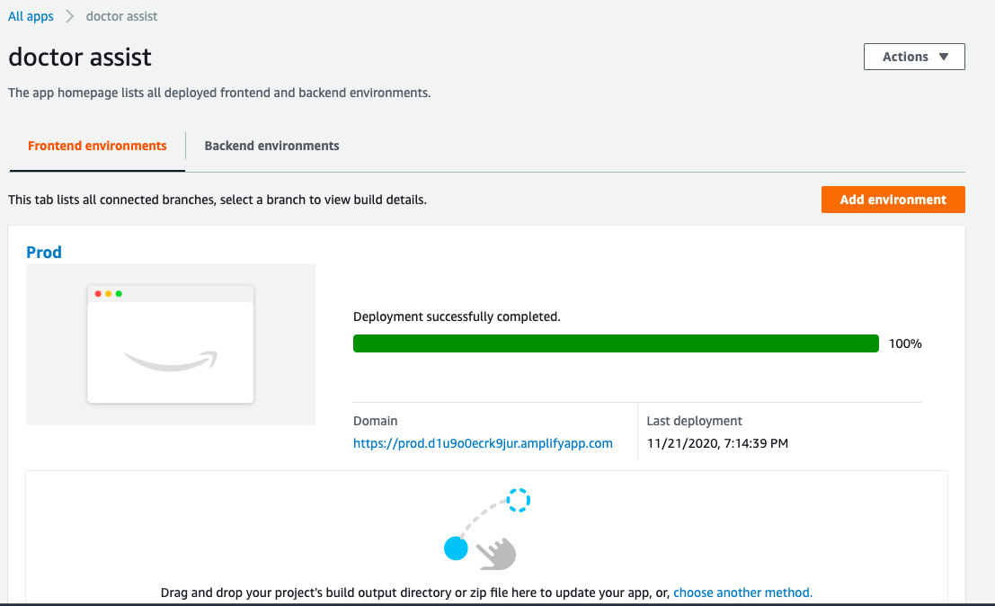
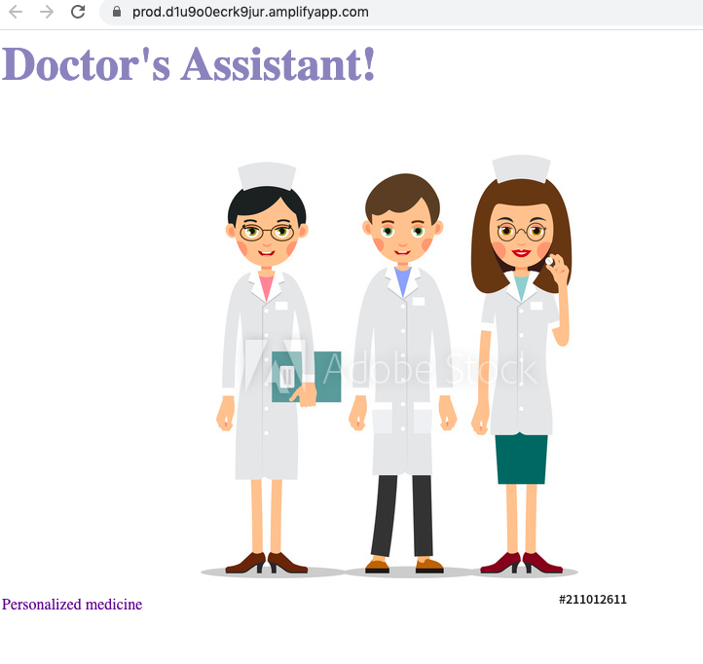

Slide 14

Summary of AWS Amplify
Level of complexity
Not complex
Time spent
8-10 minutes
Cost
A few dollars at start
Performance
Good

Slide 15
EFFICIENCY
AWS amplify
Overall Summary
COST
AWS S3
OVERALL PERFORMANCE
AWS Amplify and AWS Lightsail

Slide 16
Thank you

